Slide 1

Cloud-Orchestrated Book Exchange and Lending Lifecycle Management System
CSA4305-Internet Programming
Supervised by:
Dr D Sudhagar
Presented by:
E.Goutham-192311190
G.Abinay-192373062
A Revanth Kumar-192372244
A Ganesh Ram Kamal -192311183

Slide 2


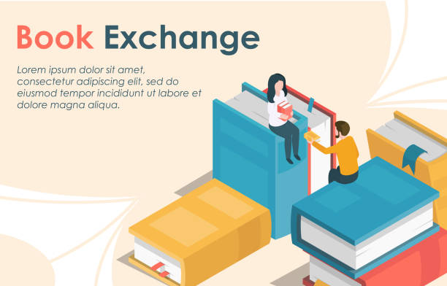
Abstract
This project develops a centralized web platform that enables users to list, search, lend, and borrow books within a community. It promotes book sharing, reduces resource wastage, and encourages learning through an accessible, reliable, and user-friendly system. The platform also helps users connect easily with book owners, making the exchange process simple and efficient.

Slide 3

Introduction
Access to books is challenging for many students due to high costs and limited availability. A cloud-based book exchange platform enables users to lend, borrow, and share books within their community, promoting knowledge sharing and reducing resource wastage.
The system is designed with two main modules:
Book Listing
Lending and borrowing Management

Slide 4
Problem Identification
Manual Process Issues: Book lending and borrowing are often handled manually, making the process slow, unorganized, and difficult to track.
No Centralized Platform: Users cannot easily view available or borrowed books, leading to confusion and inefficient sharing.
Limited Community Interaction: The lack of a common platform makes it difficult for book owners and borrowers to connect, reducing community participation.

Slide 5
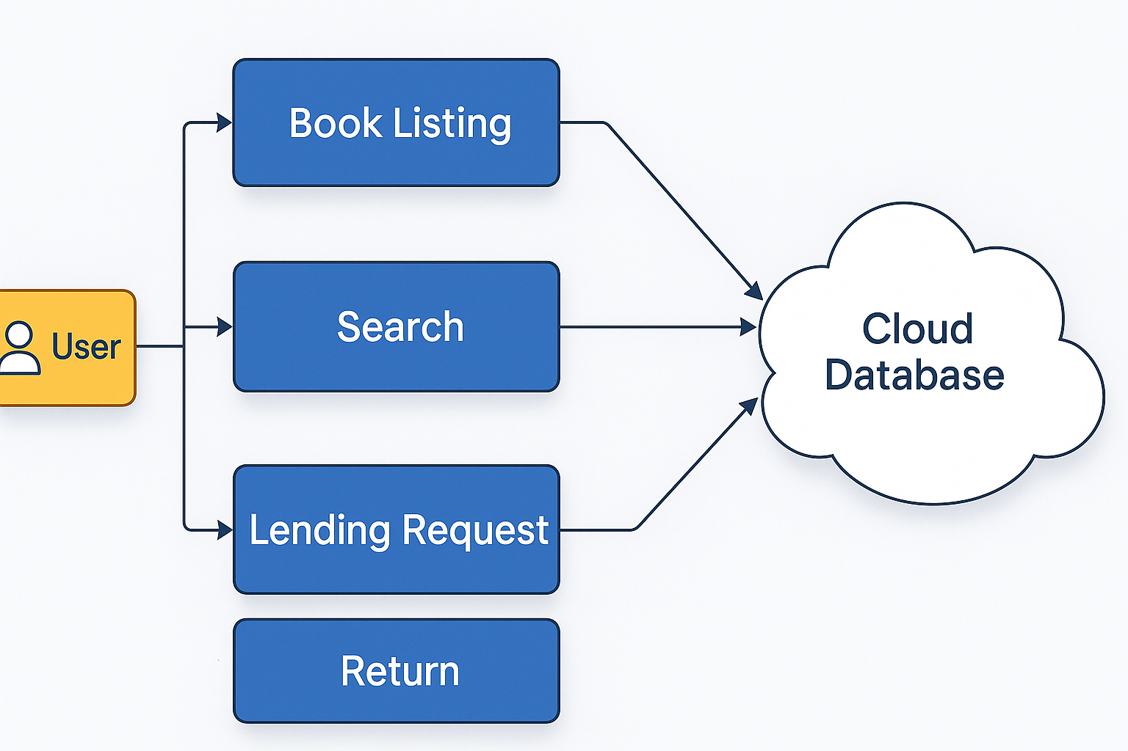
System Architecture Diagram

Slide 6
Literature Review
Author / Year | Title / Source | Key Contribution | Relevance to Current Project | Limitations / Gaps
Salunke & More (2025) | Design and Development of a Digital Platform for Peer-to-Peer Book Exchange | Proposed a digital platform for community-driven book exchange. | Directly supports the idea of allowing users to list books with other users for book exchange. | Mainly focuses on book exchange end, donate, or controlled contact sharing after request approval.
Scholz et al. / European Economic Review (2024) | Sharing with Minimal Regulation? Evidence from Neighbor hood Book Exchange | Studies peer-to-peer book exchange and finds that social norms and community-based book sharing. | Supports the concept of community members sharing books directly centralized physical library. | Based on informal physical book exchanges; authentication.
Hidayat-ur-Rehman et al. (2026) | Empirical Analysis to Investigate the Relationship Between Digital Sharing Economy and Digital Trust | Identifies factors such as security, competence, integrity, familiarity, digital sharing platforms. | Highly relevant to your request approval and contact-reveal mechanism, when connecting with strangers. | General sharing-economy research rather than specifically focused on book-sharing platforms.

Slide 7
Modules
Literature Review / Background
Module 1: User Authentication & Profile Management
Module 2: Book Management
Module 3: Book Exchange & Lending Management
Module 4: Cloud Storage & Admin Dashboard

Slide 8
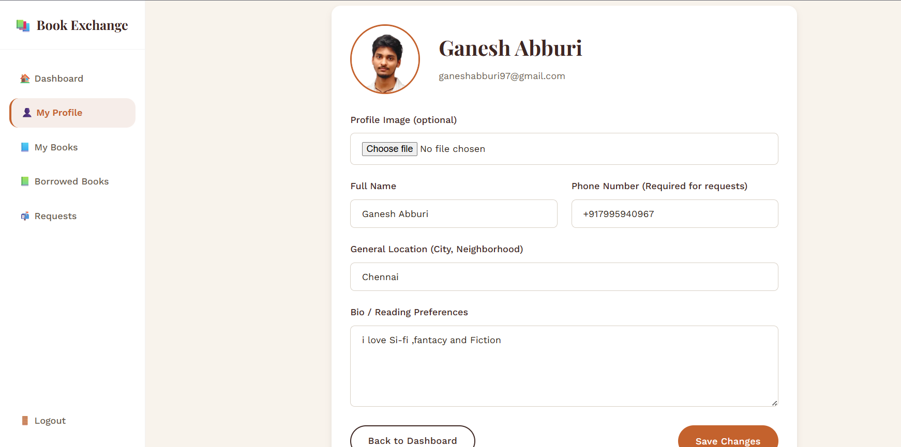
Module 1: User Authentication & Profile Management
Literature Review / Background
Purpose: Manage user accounts securely.
Features:
User Registration
User Login/Logout
Password Reset
User Profile Management
Role-based Access (User/Admin)
Input: User details (name, email, password)
Output: Authenticated user account and profile

Slide 9
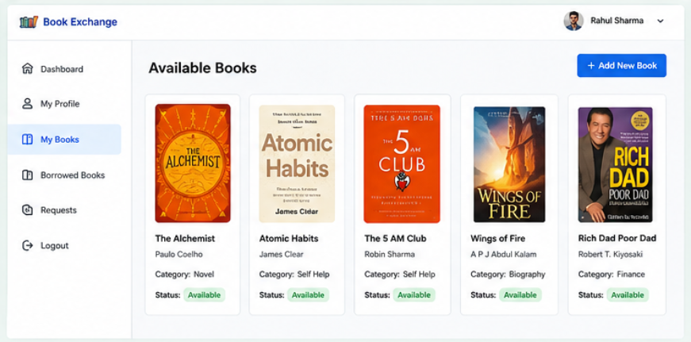
Module 2: Book Management
Purpose: Allow users to add and manage books for exchange or lending.
Features:
Add New Book
Edit/Delete Book
Upload Book Cover Image
Categorize Books (Novel, Academic, Magazine, etc.)
View Available Books
Input: Book title, author, category, description, availability.
Output: Book catalog stored in the cloud database.

Slide 10
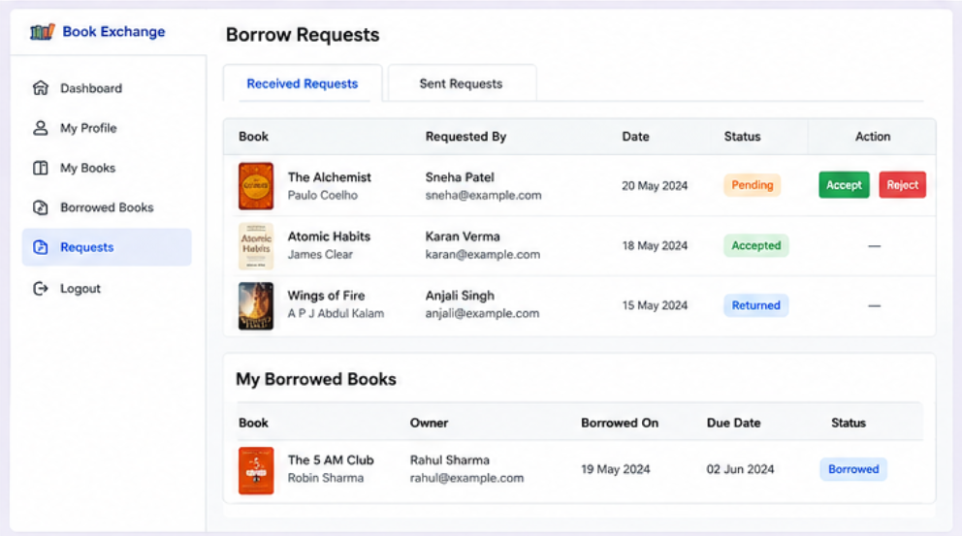
Module 3: Book Exchange & Lending Management
Purpose: Handle borrowing and lending requests.
Features:
Search Books
Send Borrow Request
Accept/Reject Request
Track Borrowing Status
Return Book Confirmation
Borrowing History
Input: Book request from borrower.
Output: Updated lending status and borrowing records.

Slide 11
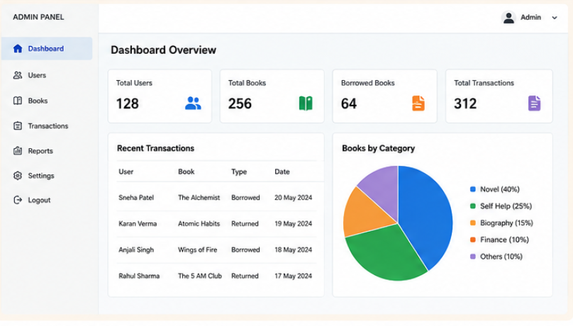
Module 4: Cloud Storage & Admin Dashboard
Purpose: Manage the platform and store data securely on the cloud.
Features:
Cloud Database Integration
Store Book Images
User Management
Book Management
Monitor Lending Activities
Generate Reports (Users, Books, Transactions)
Input: Platform data from users and books.
Output: Administrative reports, analytics, and secure cloud-based data management.

Slide 12
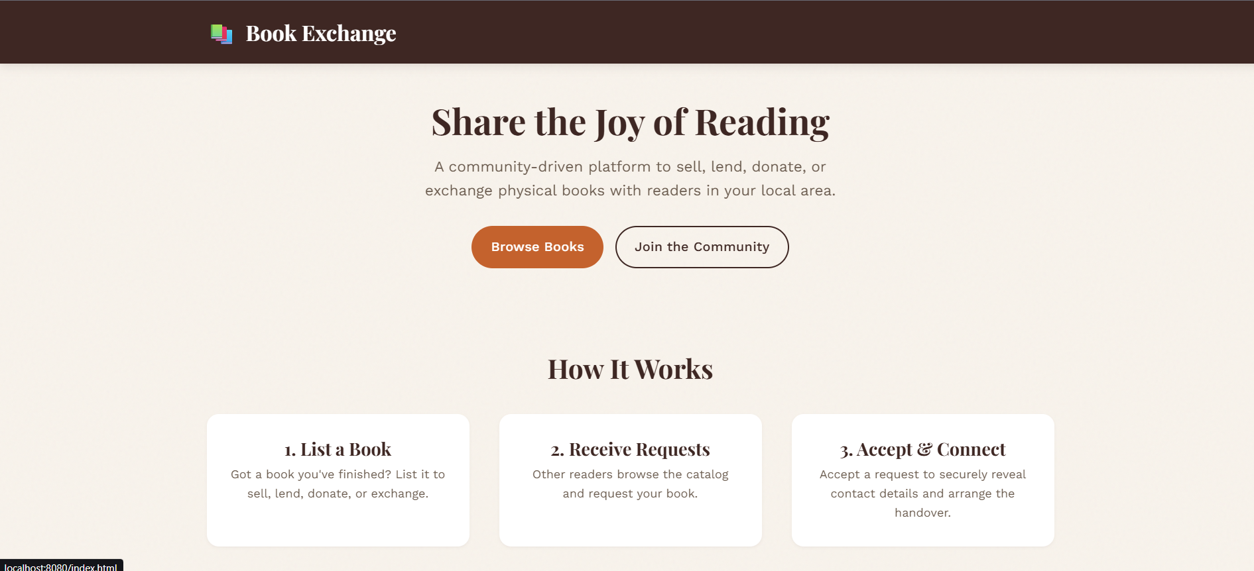
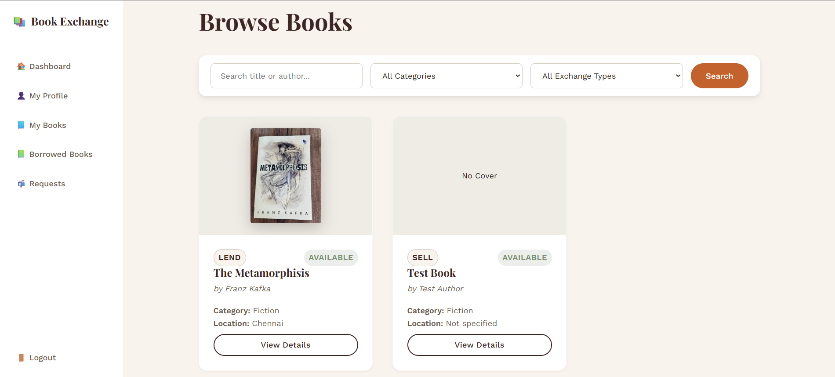
OUTPUT

Slide 13
SDG
1.Quality Education
Promotes access to educational and reference books by allowing users to share, lend, donate, and exchange books at low or no cost.
2. Reduced Inequalities
Helps people who may not be able to afford books by connecting them with users willing to lend or donate books.
3. Responsible Consumption and Production
Encourages reuse and sharing of existing books, reducing unnecessary purchases and extending the useful life of physical books.
4. Sustainable Cities and Communities
Builds stronger local communities by creating a platform where people can connect and share resources with one another.

Slide 14
Future Scope
The platform can be further improved by adding user ratings and reviews to build trust, barcode scanning for quick book listing, multilingual support for wider accessibility, and AI-based recommendations to suggest books based on user interests and activity.
Language Support: Adding multilingual features to make the platform usable for a wider, diverse audience.
AI-Based Recommendations: Implementing machine learning algorithms to suggest books based on user behavior and past activity.

Slide 15

Conclusion
The cloud-based book exchange and lending platform successfully addresses the need for a community-driven system that promotes sharing, reduces book wastage, and enhances access to educational resources.
Overall, the project demonstrates how cloud-based technology can be effectively used to build sustainable, accessible, and socially impactful solutions for community sharing.

Slide 16
References
S. Sharma and A. K. Sharma, "Cloud computing for library services: A conceptual framework," International Journal of Computer Applications, vol. 178, no. 7, pp. 9–13, Nov. 2020.
L. Qian, Z. Luo, Y. Du, and L. Guo, "Cloud computing: An overview," in Proc. 1st Int. Conf. Cloud Computer., Beijing, China, Dec. 202, pp. 626–631.
M. Hossain and M. S. Hossain, "Design and implementation of a digital library management system using cloud storage," International Journal of Computer Science Issues (IJCSI), vol. 19, no. 1, pp. 15–22, Jan. 2022.

Slide 17
Thank you!

